Slide 1

Improving Pokemon Go
Ryan Devlin

Slide 2

http://cooldownpodcast.com/wp-content/uploads/2016/07/Pokemon-GO-Logo-Wallpaper.jpg
Notes:
Generated 200 million first month. 66 million users first month

Slide 3
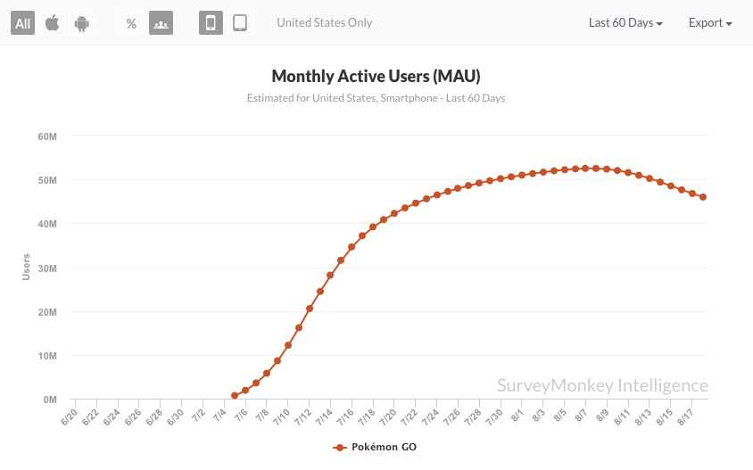
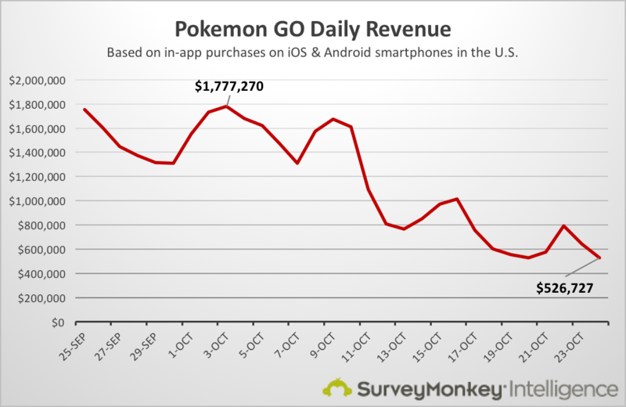
The Problem
http://static2.businessinsider.com/image/57c04d1009d2937a048b49fd-844/pokemongo_monthlyactiveusers.png
http://gonintendo.com/system/file_uploads/uploads/000/019/386/original/pokemon-go-daily-revenue.png
Notes:
By November, 23 Million AU per month
Reached 950 million at end of year, despite pace to make 1.2 Billion

Slide 4
Market Research
Not intuitive
Not efficient
TRACKER!

Slide 5
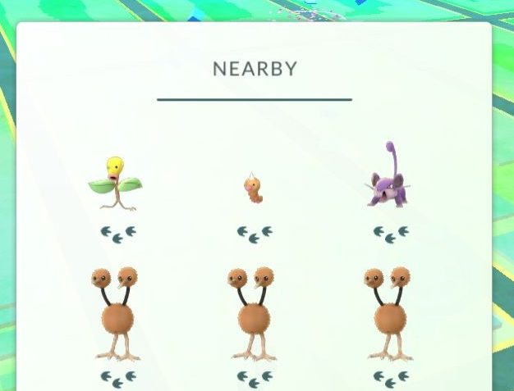
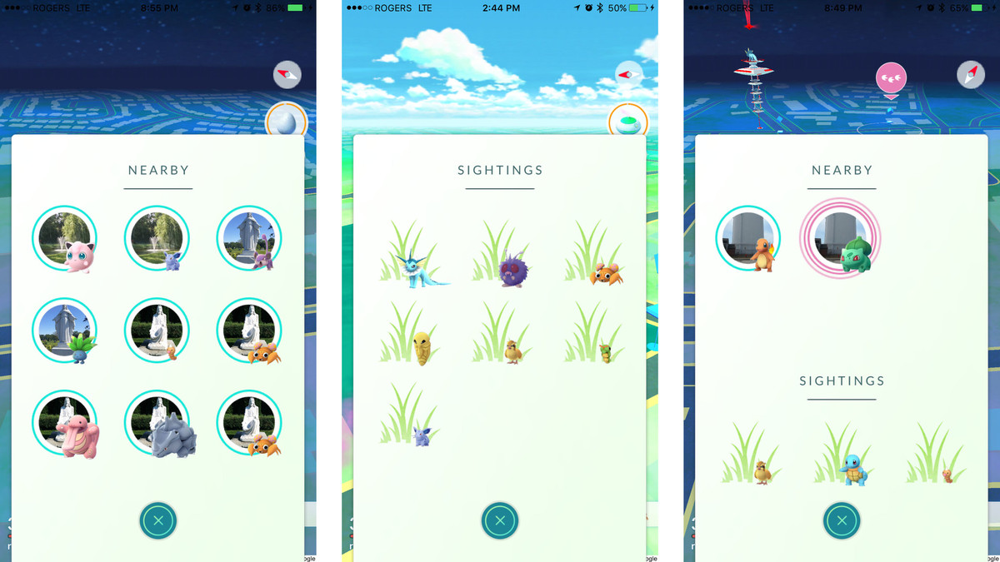
https://www.imore.com/sites/imore.com/files/styles/larger/public/field/image/2017/01/pokemon-go-nearby-sightings-both.jpg?itok=LNGLEGIf
Notes:
Had to change because of performance issues

Slide 6
How To Fix?
Enhanced Audible and Haptic Feedback
Fix Pokemon Encounter Screen with Regards to Pokeballs and Berries
Increase Intuitiveness with Healing
Add Default Gym Team Selection
Increase Effectiveness of the Tracking Feature

Slide 7
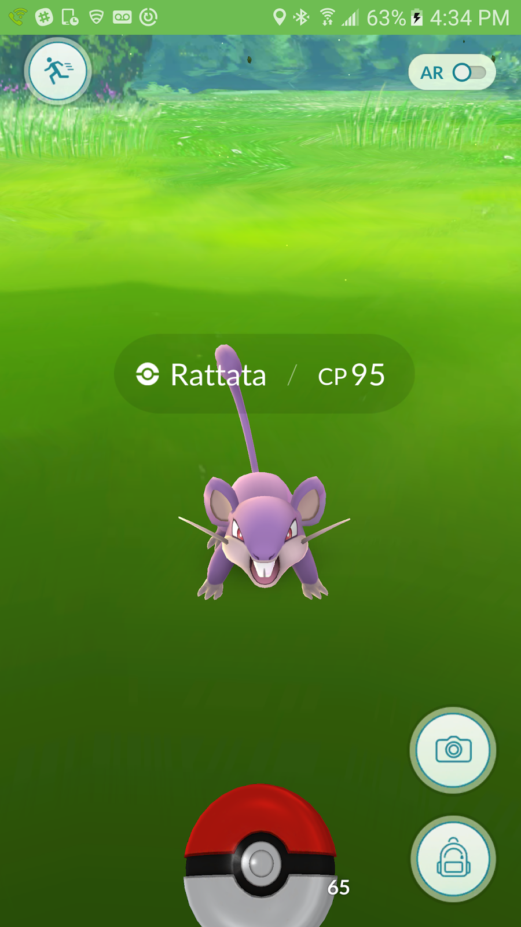
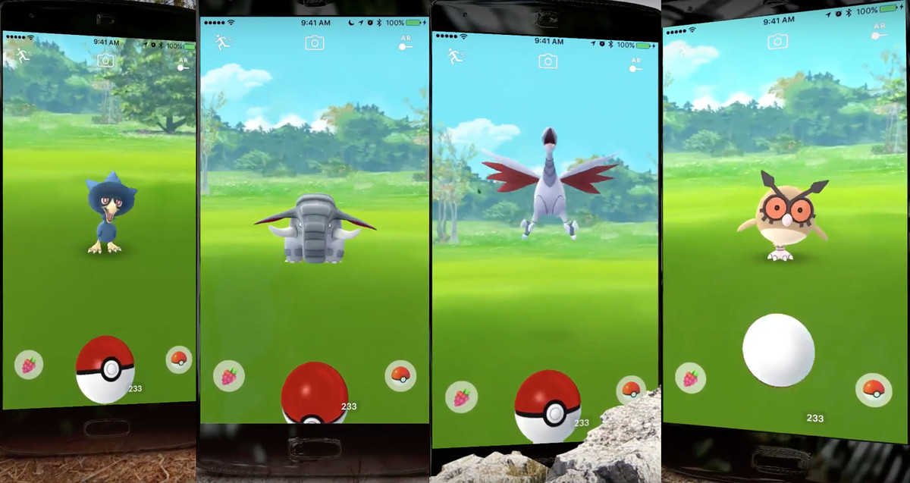
https://3.bp.blogspot.com/-dFGToPKPxEE/V4BF_NJP6LI/AAAAAAAAACA/9AAxk-LE6GQ1U07M2993sl2lI4HTrHgkwCLcB/s1600/Screenshot_20160708-163426.png
http://listforus.net/wp-content/uploads/2017/02/Pokemon-Go-Generation-2-Highest-CP-List.jpg
Notes:
Unintuitive backpack icon is replaced with pokeball and berry icons

Slide 8
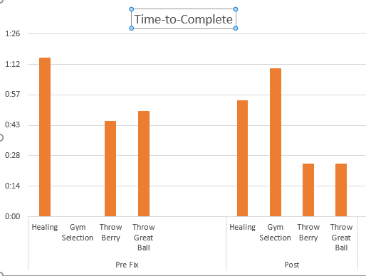
Usability Testing
Pre-development – Cognitive Walkthrough
Post-development – Empirical testing.
In lab
Real-World
Notes:
Gym Selection is a new feature, therefore no pre-fix data Gym selection had higher error and time-to-complete, revisions planned for future release

